Slide 1
Data Engineering Hackathon
Approach Presented by:-
Akshay Thorat

Slide 2
Problem Statement
With the dataset provided, the participants need to analyse and create features of the following description.
'DATE': create the date from year, month and day of the week
'LOW': Lower value of DEP_TIME_BLK
'HIGH': Higher value of DEP_TIME_BLK
'TIMESTAMP': create a timestamp with date and lower value of DEP_TIME_BLK
'WIND_CHILL': the perceived temperature due to cooling effect of wind blowing
'PRCP_SNOW_RATIO': ratio of precipitation and snow
'PLANE_AGE_AIRLINE_AIRPORT_FLIGHTS_MONTH_RATIO': ratio of plane age and airline and airport flights months.
'SEAT_DISTRIBUTION': Ratio of seats and in concurrent flight CONCURRENT_FLIGHTS
'SEAT_DISTRIBUTION_NORMALISED': normalized values of ratio of seats and in concurrent flight

Slide 3
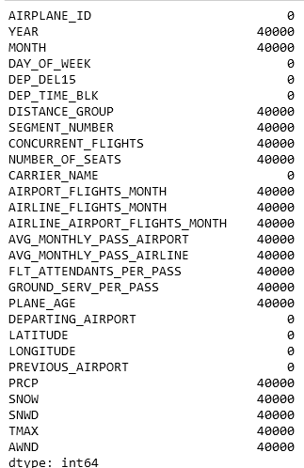
Checking for Missing Values
My first step was to check for the missing values in the dataset
40 thousand datapoints were missing from most of the columns.
To impute missing values, different strategies were used for different columns.

Slide 4
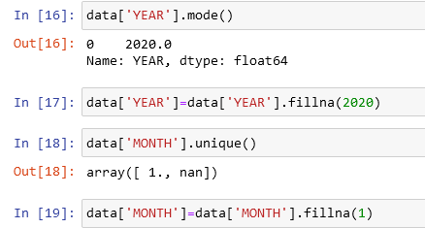
Missing Value Imputation-Date Time Features
For Datetime features like ‘Month’ and ‘Year’, it was observed that there is only one unique value apart from null values.
For Month it was ‘1’ and for Year it was ‘2020’
Same values were filled in the place of null values

Slide 5
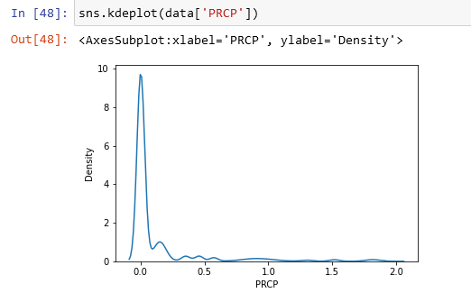
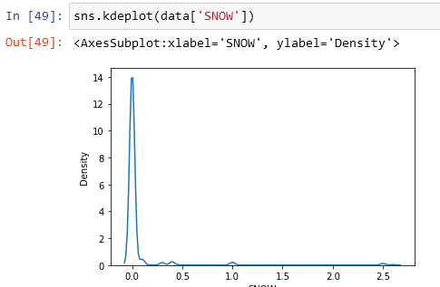
Missing Value Imputation-’SNOW’,’PRCP’,’SNWD’
For following three features, it was observed that the distribution is leptokurtic and rightly skewed.
Also, most of the values were centered around ‘0’
Initially missing values were replaced by ‘0’.
But later, replacing missing value with median is considered

Slide 6
Missing Value Imputation-Multivariate Imputation
For remaining features, multivariate imputation strategy was used.
Sci-kit learn’s Iterative Imputer was used for this process
For estimator, linear regression is used which is simpler and faster than other estimators

Slide 7
Calculating ‘Submission’ features from ‘dataset’ features
Wind Chill Temperature is given by the formula==> 35.74 + 0.6215×T - 35.75×V^0.16 + 0.4275×T×V^0.16
Here T is ‘TMAX’ feature of dataset given and V ( wind speed) extracted from ‘AWND’ feature.
For Precipitation Snow Ratio, ‘PRCP’ is divided by the sum of ‘SNOW’ and ‘SNWD’
Similarly: -

Slide 8
Thank You

Slide 9

About Me
I am a Data Explorer with a professional background in Banking and Insurance. Data Visualization and gaining Insights from the data interests me. Apart from Data exploring, I love to go for Hiking.

